Slide 1
Introduction to Raspberry Pi
Ms. Kritika Purohit
Assistant Professor
CSE

Slide 2
Points to be covered
Introduction to Raspberry Pi
Versions
Components
Configuration
Assembling the kit
Hardware Connections
Software Set-up
OS Installation Process

Slide 3
Introduction
The Raspberry Pi is a remarkable device: a fully functional computer in a tiny and low-cost package.
The Raspberry Pi is known as a single-board computer, which means exactly what it sounds like: it is a computer, just like a desktop, laptop, or smartphone, but built on a single printed circuit board.
The Raspberry Pi is small – roughly the same footprint as a credit card – but that doesn’t mean it’s not powerful: a Raspberry Pi can do anything a bigger and more power-hungry computer can do, though not necessarily as quickly.
The Raspberry Pi family was born from a desire to encourage more hands-on computer education around the world.

Slide 4
Introduction
Various models of Raspberry Pi have been released since the original Model B, each bringing either improved specifications or features specific to a particular use-case.
All Raspberry Pi models have one thing in common, though: they are compatible, meaning that software written for one model will run on any other model. It is even possible to take the very latest version of the Raspberry Pi’s operating system and run it on an original pre-launch Model B prototype. It will run more slowly, it is true, but it will still run.
Unlike a traditional computer, which hides its inner workings in a case, a Raspberry Pi has all its components, ports, and features out on display – although you can buy a case to provide extra protection, if you’d prefer.

Slide 5
Versions of Raspberry Pi
There are different versions of raspberry pi available as listed below:
Raspberry Pi 1 Model A
Raspberry Pi 1 Model A+
Raspberry Pi 1 Model B
Raspberry Pi 1 Model B+
Raspberry Pi 2 Model B
Raspberry Pi 3 Model B
Raspberry Pi Zero
Out of the above versions of Raspberry Pi, more prominently use Raspberry Pi and their features are as follows:

Slide 6
Features | Raspberry Pi Model B+ | Raspberry Pi 2 Model B | Raspberry Pi 3 Model B | Raspberry Pi zero
SoC | BCM2835 | BCM2836 | BCM2837 | BCM2835
CPU | ARM11 | Quad Cortex A7 | Quad Cortex A53 | ARM11
Operating Freq. | 700 MHz | 900 MHz | 1.2 GHz | 1 GHz
RAM | 512 MB SDRAM | 1 GB SDRAM | 1 GB SDRAM | 512 MB SDRAM
GPU | 250 MHz Videocore IV | 250MHz Videocore IV | 400 MHz Videocore IV | 250MHz Videocore IV
Storage | micro-SD | Micro-SD | micro-SD | micro-SD
Ethernet | Yes | Yes | Yes | No
Wireless | WiFi and Bluetooth | No | No | No
Versions of Raspberry Pi

Slide 7
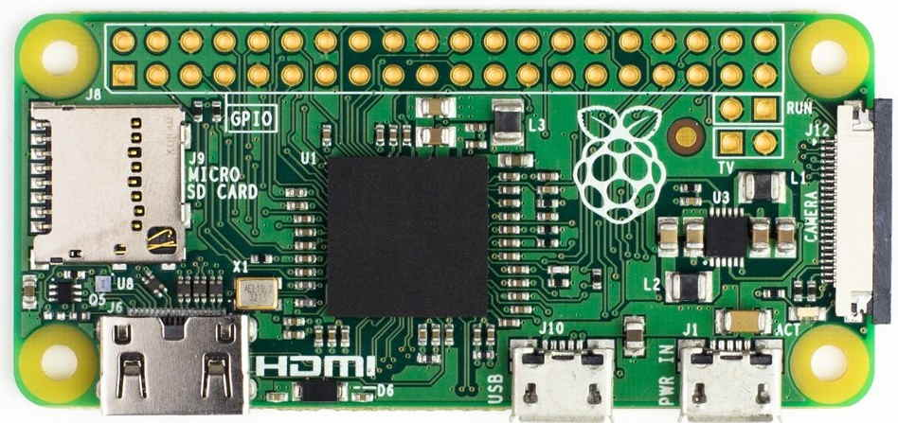

Slide 8
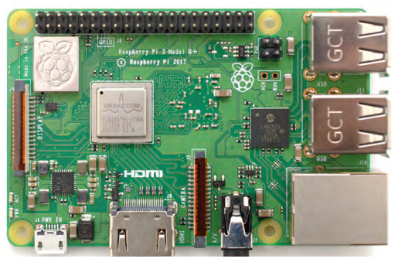

Slide 9
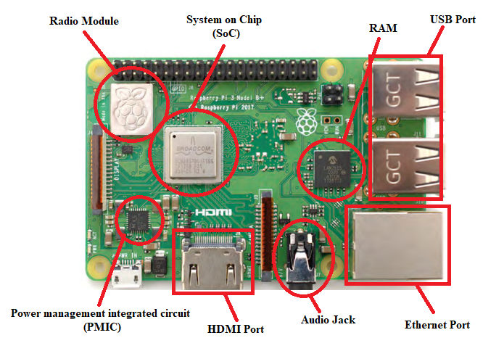

Slide 10
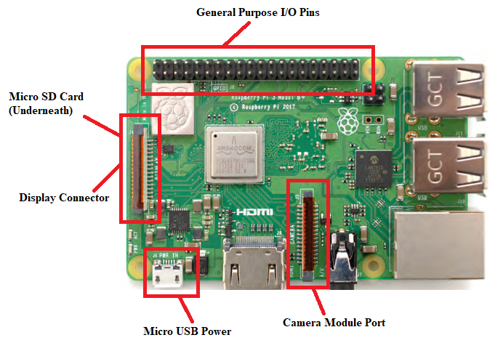

Slide 11
Configuration
1.4 GHz 64-bit quad-core ARM Cortex-A53, 1GB RAM
2.4/5Ghz dual band 802.11ac Wireless LAN, 10/100/1000Mbps Ethernet
Bluetooth 4.2
4 USB ports, Full HDMI port, Combined 3.5mm audio jack and composite video port, 40 GPIO pins
Micro SD card slot, VideoCore IV 3D graphics core, Camera interface (CSI), Display interface (DSI),

Slide 12
Assembling the Raspberry Pi Kit
The Raspberry Pi has been designed to be as quick and easy to set up and use as possible, but – like any computer – it relies on various external components, called peripherals.
USB power supply – A power supply rated at 2.5 amps (2.5A) or 12.5 watts (12.5W) and with a micro USB connector. The Official Raspberry Pi Power Supply is the recommended choice, as it can cope with the quickly switching power demands of the Raspberry Pi.
MicroSD card with NOOBS – The microSD card acts as the Raspberry Pi’s permanent storage; all the files you create and software you install, along with the operating system itself, are stored on the microSD card. Using a card with NOOBS, the New Out-Of-Box Software, pre-installed will save you some time;

Slide 13
Assembling the Raspberry Pi Kit
USB keyboard and mouse – The keyboard and mouse allow you to control the Raspberry Pi. Almost any wired or wireless keyboard and mouse with a USB connector will work with the Raspberry Pi, though some ‘gaming’ style keyboards with colorful lights may draw too much power to be used reliably.
HDMI Cable – The HDMI cable carries sound and pictures from the Raspberry Pi to your TV or monitor.
The Raspberry Pi is safe to use without a case, providing you don’t place it on a metal surface which could conduct electricity and cause a short-circuit. The Starter Kit includes the Official Raspberry Pi Case.
If you want to use the Raspberry Pi on a wired network, rather than a wireless (Wi-Fi) network, you’ll also need a network cable. This should be connected at one end to your network’s switch or router.

Slide 14
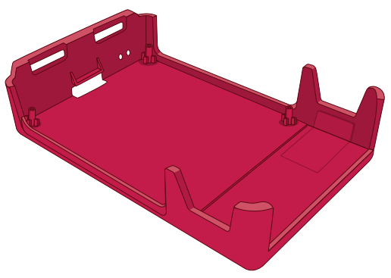
Assembling the Raspberry Pi Kit
If we are installing our Pi in a case, it should be our very first step. If we’re using the Official Raspberry Pi Case, we will begin with splitting it into its five individual pieces: the red base, two white sides, red upper, and white lid.
Step 1:- Take the base and hold it so that the raised end is to your left and the lower end to your right.

Slide 15
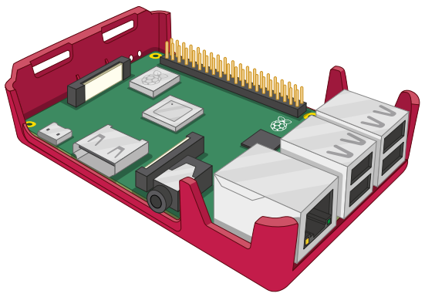
Assembling the Raspberry Pi Kit
Step 2:- Holding the Pi by its USB and Ethernet ports, with the GPIO header to the top, slot the left-hand side into the case at an angle, then gently lower the right-hand side down so it sits flat.

Slide 16
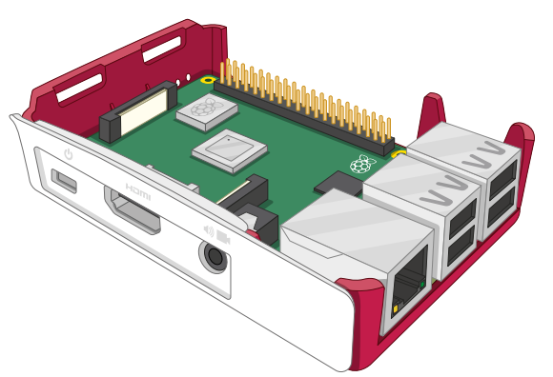
Assembling the Raspberry Pi Kit
Step 3:- Take the two white side pieces and find the one with the cut-outs for the power connector, HDMI port, and 3.5 mm AV jack. Line it up with the ports on the Raspberry Pi and gently push it home until you hear a click.

Slide 17
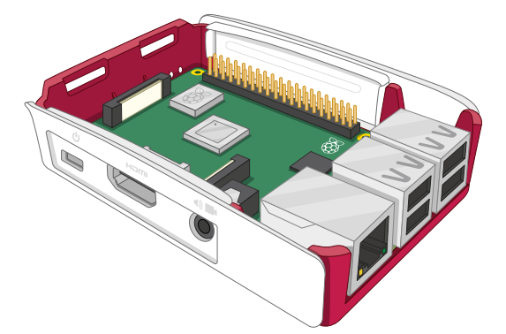
Assembling the Raspberry Pi Kit
Step 4:- Take the solid white side piece and click it in to the GPIO header side of the case.

Slide 18
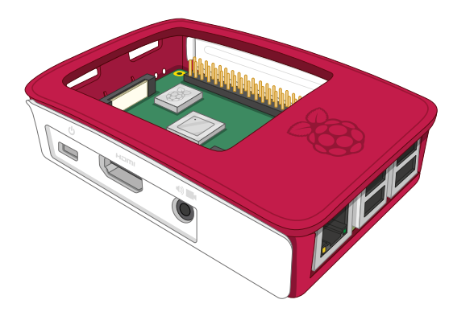
Assembling the Raspberry Pi Kit
Step 5:- Take the red plastic upper piece and place the two clips at the left into the matching holes on the left of the base, above the microSD card slot. When they’re in place, push the right-hand side (above the USB ports) down until you hear a click.

Slide 19
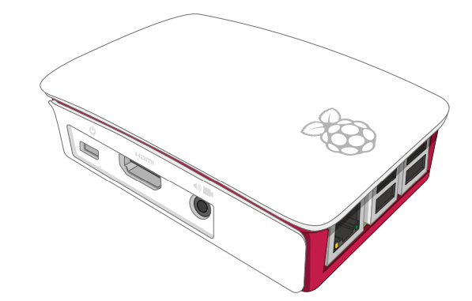
Assembling the Raspberry Pi Kit
Step 6:- Finally, take the white lid and hold it so that the Raspberry Pi logo is to your right and the small raised clips on its underside are lined up with the hole on the top of the case, then gently push it down until you hear a click. Your case is now fully built.

Slide 20
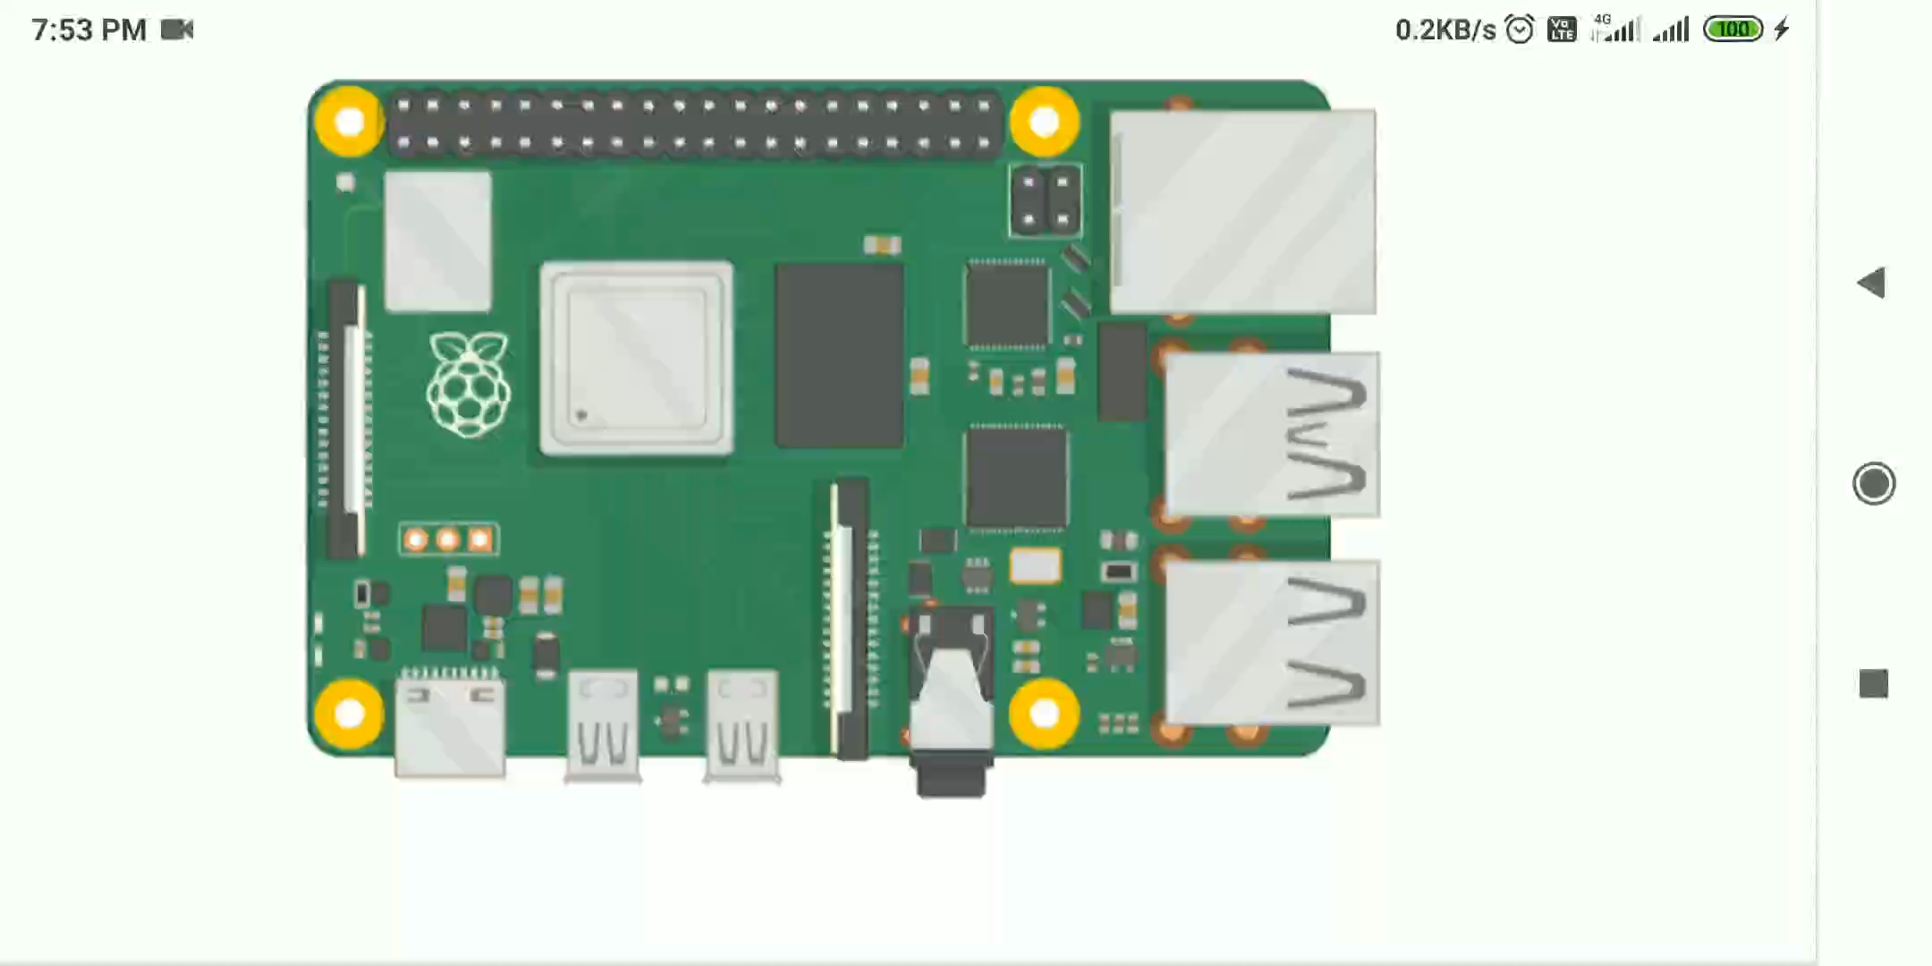

Slide 21
Hardware Connection
Connecting the microSD card- To install the microSD card, which is the Raspberry Pi’s storage, turn the Raspberry Pi over and slide the card into the microSD slot with the label facing away from the Pi. It can only go in one way and should slide home without too much pressure.
Connecting a keyboard and mouse- Connect the keyboard’s USB cable to any of the four USB ports on the Raspberry Pi. When the keyboard is connected, simply do the same for the mouse.
Connecting a display- Take the HDMI cable and connect one end – it doesn’t matter which – to your Raspberry Pi and the other end to your display. If your display has more than one HDMI port, look for a port number next to the connector itself; you’ll need to switch the TV to this input to see the Pi’s display

Slide 22
Hardware Connection
Connecting a network cable (optional)- To connect your Raspberry Pi to a wired network, take a network cable – known as an Ethernet cable – and push it into the Pi’s Ethernet port, with the plastic clip facing downwards, until you hear a click.
Connecting a power supply- Connecting the Raspberry Pi to a power supply is the very last step in the hardware setup process, and it’s one you should do only when you’re ready to set up its software: the Raspberry Pi does not have a power switch and will turn on as soon as it is connected to a live power supply. First, connect the micro USB end of the power supply cable to the micro USB power connector on the Raspberry Pi.

Slide 23
Software Set-up
Before we start using the Raspberry Pi in earnest, we need to set up its software i.e. it’s operating system, the software which controls what the Pi can do.
NOOBS, the New Out-Of-Box Software, is designed to make this as easy as possible, allowing us to choose from several different operating systems and install them automatically.
Step 1:- When the Pi is first switched on, or booted, with a fresh installation of NOOBS on its microSD card, we will see a screen with the Raspberry Pi logo on it and a small progress window at the upper-left. After a short pause, which can take up to a minute the first time we use the NOOBS microSD card.

Slide 24
Software Set-up
It displays the NOOBS menu a system which lets you choose the operating system to run on your Pi. Two operating systems are included with NOOBS as standard: Raspbian, a version of the Debian Linux operating system tailored specifically for the Raspberry Pi; and LibreELEC, a version of the Kodi Entertainment Centre software.
Step 2:- Select Raspbian OS and Start Installation
Step 3:- After installation/booting you will get welcome wizard to select further details.
Step 4:- Set-up a Network or Wi-Fi connection
Step 5:- Now we will get a Raspbian Desktop.

Slide 25
